Slide 1

Predicting customer buying behaviour

Slide 2
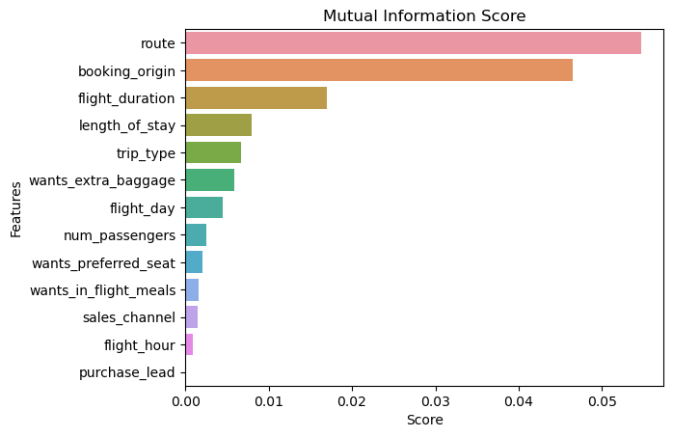
predictive model to understand factors that influence buying behavior
We have trained the Machine Learning Model with Logistic Regression Algorithm and received
ACCURACY: 85.2
AUC score: 0.5
route
booking_origin
flight_duration
trip_type
length_of_stay
are the top 5 features which influence
Customer buying behavior
We need to increase the AUC score.

